Slide 1
Module 11
Interacting with biostatistician

Slide 2
Lecture objective
Be aware of what preparation is needed before you meet with a biostatistician

Slide 3
Do you need a biostatistician?
Several times in this course we recommended to consult a biostatistician
Typically around $100/h
You would likely benefit from such consultation if:
You are planning intermediate or advanced statistics
You are planning to submit to a journal that may require the involvement of a biostatistician
Your PI/collaborators want to do things differently than what you think is right based on your new knowledge; you need backup

Slide 4
What do you need to prepare for a biostatistician?
Assume that the biostatistician has never seen your data before and is unfamiliar with your research topic
Your job is to bring them up to speed
Ideally, you would consult BEFORE you start your experiments (often done at time of grant proposal).
Explain (ideally in writing, can be guided by STROBE or other guidelines) :
Context (briefly)
Research question/ research objective
What is your primary endpoint or measure of interest?
Your hypothesis (null and alternate) (must be testable)

Slide 5
What do you need to prepare for a biostatistician?
Explain (ideally in writing, can be guided by STROBE or other guidelines) :
Type of study you are planning (longitudinal, case-control, etc.), be prepared to explain why you are doing it this way as they may have other suggestions
Inclusion/exclusion criteria (if applicable)
Variables (continuous vs categorical) and their definition
Exploratory or confirmatory?
Share preliminary data and sample size/power calculations if relevant
Bring visuals of your data if you have it

Slide 6
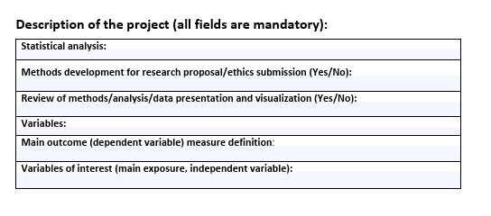
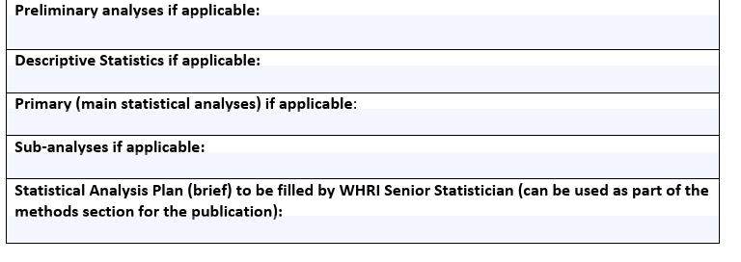
Example of a biostatistical support request form

Slide 7
Cost
Cost varies from free or partly free (as part of a UBC courses offering statistical consulting to UBC students):
To $100 or more per hour
Preparation is key to keeping costs down
Be clear in whether you want the biostatistician to
Help you design a study
Help you do the stats on your data yourself; you are consulting to ensure you are doing it correctly
Do the analysis for you
ALWAYS clear this with your PI beforehand
https://www.stat.ubc.ca/need-help-your-data

